Slide 1

Professional Accounting Achieve Your Goal With Us
TALLY
ACCOUNTING
AI BASED (CLOUD ACCOUNTING)
GST
TDS
INCOME TAX
CAREEER
EXCEL & ADVANCE EXCEL

Slide 2
Chepter-1 Accounting Fundamentals TALLY PRIME
Accounting Convention & their Importance
Types of Accounts and Double Entry Accounting System
Journal Accounting
Types and rectification of Mistakes
Bank Reconciliation in tally
Finalization of Accounts : Trading, P & L A/C and Balance sheet
Accounting in Cloud based

Slide 3


Chapter-2 Indirect Tax (GST) TALLY PRIME
History and impact of GST
Understanding of GST (CGST/SGST/IGST)
Important DEFINATIONS under GST
Meaning and Scope of supply
GST-Practical- Tally Prime
Forward and Reverse Charge Mechanism
Tax Invoice, Credit and debit Note
Input Tax Credit & Transfer of Input Tax Credit
Accounts and Records
Online & offline Payments of Taxes & Interest
How to File Gst Return (GSTR-1 , GSTR-2, GSTR-3 ETC)
E Way Bill
Tax Deducted At Source
Penalty
Assessment & Audit
This Photo by Unknown Author is licensed under CC

Slide 4
Indirect Tax (GST)
Export/Import in GST
E invoice
Amendment in GST
ISD in GST
Interest & penalty calculation in GST

Slide 5
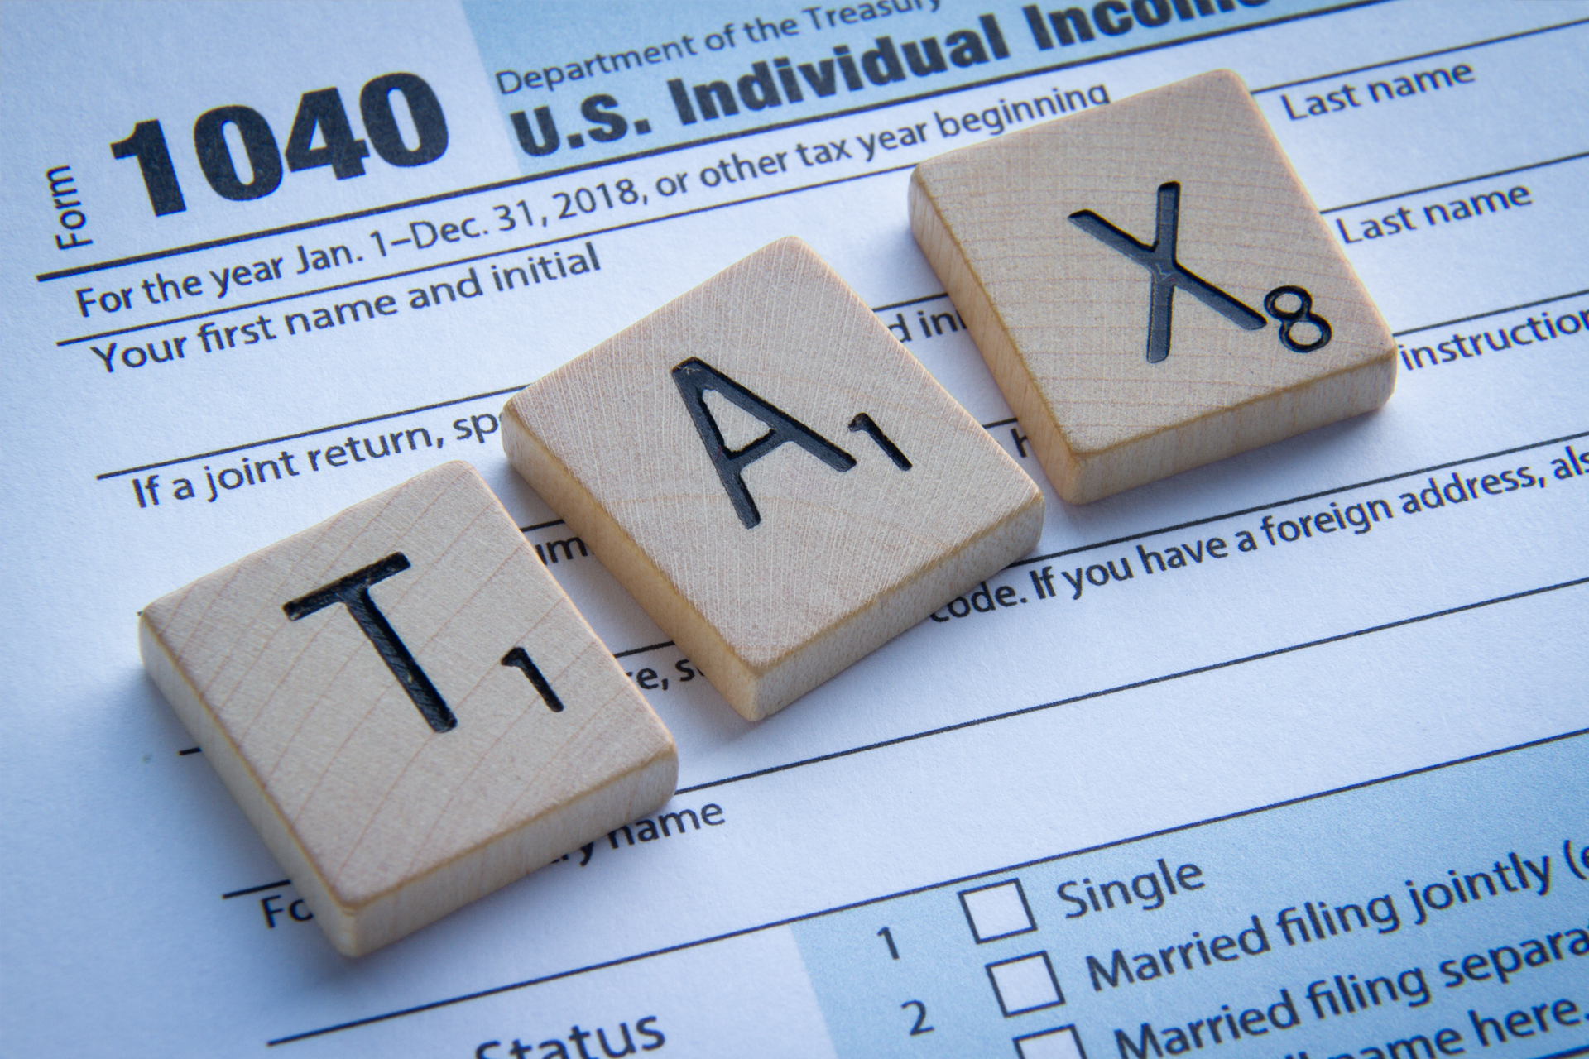
Chepter-3 Direct Tax (Income Tax – TDS) Tally PRIME
Tax Deducted At Source (TDS)/Tax Collected & Tax Liability
Types and Role Of Direct Taxes in Business
Basic understanding of Different Heads Of Income
- Income From Salary
- Income From House Property
- Income From Business and Profession
- Income From Capital Gain
- Income From Other Sources
Advance Tax
Computation of Total Income and Tax Liability
Online Payment of TDS and Income Tax
Types of Audit
Tax Return Preparation for Individual
This Photo by Unknown Author is licensed under CC BY-ND

Slide 6
Direct Tax (TDS Part in income tax)
Tax deducted at source under Sections
Rate limit under TDS
Due date of TDS payment
Due date of Return
TCS on Income
Interest on TDS
Let Fees on TDS

Slide 7
Chapter-4 Banking & Com
Internet Banking
Online Payments of Taxes
Different Types of Bank accounts & Bank Loans
Understanding Modern Banking
IMPS,NEFT, RTGS

Slide 8
Chapter-5 Basic & Advances Excel
Basic Computer Techniques
MS Excel training For Accounting
Data entry & Formatting
Formula & Data Operations
Pivot, Sort & Filter, VLOOKUP

Slide 9
Chapter-6 Soft skill & Personality Development
Face to Face Discussions
Grooming and Professional Etiquettes
Communication Skills
Mock Interviews
Resume Preparations

